Slide 1


That was Then…This is Now:
Celebrating PETE’s Past While Facing The Challenges In Its Future
Mike Metzler
Georgia State University
Lynn Housner
West Virginia University
Invited paper at the NASPE PETE Conference, Myrtle Beach, SC.
October, 2009

Slide 3
Hoffman, 1971
Which is better?—the traditional “PE method” or some of the more innovative, theory-based methods that had been introduced in the previous several years.
Hoffman, S. J. (1971). Traditional methodology: Prospects for change. Quest, Monograph XV, pp. 51-57.

Slide 5
Hoffman,1971…
“The writer confesses that he does not know what behaviors constitute good teaching and welcomes enlightenment. Regardless of the real or imagined merits of any method, new alternatives for teaching are always worthy of at least systematic and patient exploration.” (p. 56)
Hoffman, S. J. (1971). Traditional methodology: Prospects for change. Quest, Monograph XV, pp. 51-57.

Slide 6


Slide 7
Locke, 1977…
“By stretching things a little we have accumulated no more than 50 studies, but the movement is underway and gaining momentum. If we have any dream of a physical education in which the instructional process is informed by knowledge born of disciplined inquiry, then the new forms of research on teaching are our foothold on the future.” (p. 11).
Locke, L. F. (1977). Research on Teaching Physical Education: New hope for a dismal science. Quest, Monograph 28, pp. 2-16.

Slide 8
PETE in the 1970s…
Research-based doctoral programs

Slide 9
PETE in the 1970s…
Research-based doctoral programs
Mosston’s Spectrum of Teaching Styles

Slide 10
PETE in the 1970s…
Research-based doctoral programs
Mosston’s Spectrum of Teaching Styles
Movement-based curriculums and instruction

Slide 11
PETE in the 1970s…
Research-based doctoral programs
Mosston’s Spectrum of Teaching Styles
Movement-based curriculums and instruction
Others

Slide 12
PETE in the 1980s…
Expanding scope of inquiry and knowledge base

Slide 13
PETE in the 1980s…
Expanding scope of inquiry and knowledge base
Journal of Teaching in Physical Education

Slide 15
PETE in the 1980s…
Expanding scope of inquiry and knowledge base
Journal of Teaching in Physical Education
Conferences on PETE research

Slide 18
PETE in the 1980s…
Expanding scope of inquiry and knowledge base
Journal of Teaching in Physical Education
Conferences on PETE research
Research-based methods texts

Slide 20
PETE in the 1980s…
Expanding scope of inquiry and knowledge base
Journal of Teaching in Physical Education
Conferences on PETE research
Research-based methods texts
New paradigms for PETE inquiry

Slide 21
PETE in the 1980s…
Expanding scope of inquiry and knowledge base
Journal of Teaching in Physical Education
Conferences on PETE research
Research-based methods texts
New paradigms for PETE inquiry
Attention to P-12 Physical Education

Slide 23
PETE in the 1980s…
Expanding scope of inquiry and knowledge base
Journal of Teaching in Physical Education
Conferences on PETE research
Research-based methods texts
New paradigms for PETE inquiry
Attention to P-12 Physical Education
Others

Slide 24
PETE in the 1990s…
Standards for Beginning Teachers

Slide 26
PETE in the 1990s…
Standards for Beginning Teachers
Curriculum Models

Slide 27
PETE in the 1990s…
Standards for Beginning Teachers
Curriculum Models
Instructional Models

Slide 28
PETE in the 1990s…
Standards for Beginning Teachers
Curriculum Models
Instructional Models
Focused conferences

Slide 29
PETE in the 1990s…
Standards for Beginning Teachers
Curriculum Models
Instructional Models
Focused conferences
Others

Slide 30
PETE in this Decade…
Standards, Assessment & Accreditation of PETE Programs

Slide 31
PETE in this Decade…
Standards, Assessment & Accreditation of PETE Programs
Explosion of research

Slide 32
PETE in this Decade…
Standards, Assessment & Accreditation of PETE Programs
Explosion of research
More acceptance in the mainstream

Slide 34
PETE Since 2000…
Standards, Assessment & Accreditation of PETE Programs
Explosion of research
More acceptance in the mainstream
Others?

Slide 35
That was Then…This is now

Slide 36
Today’s Challenges for PETE
PETE doctoral programs

Slide 37
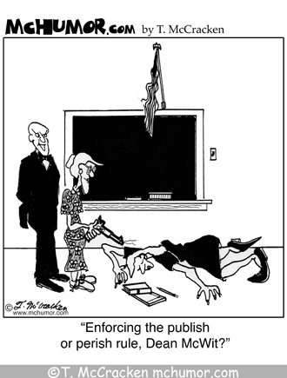

Slide 38
Today’s Challenges for PETE
PETE doctoral programs
Balancing the PETE Curriculum

Slide 39
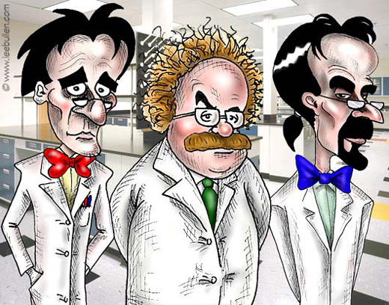

Slide 42
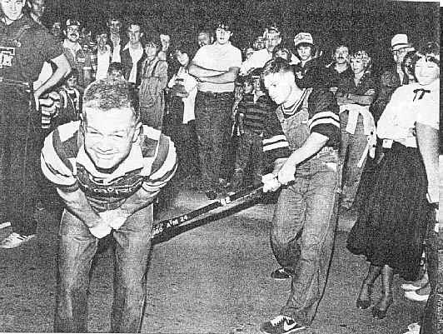

Slide 43
Today’s Challenges for PETE
PETE doctoral programs
Balancing the PETE Curriculum
Accreditation Wagging the PETE Dog

Slide 44
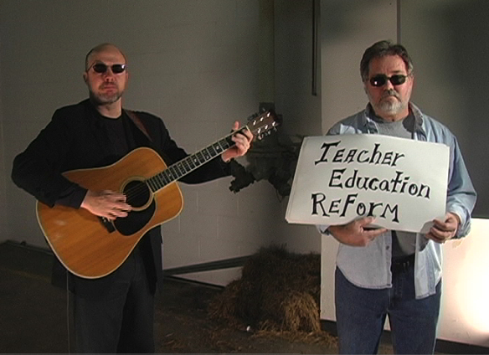

Slide 45
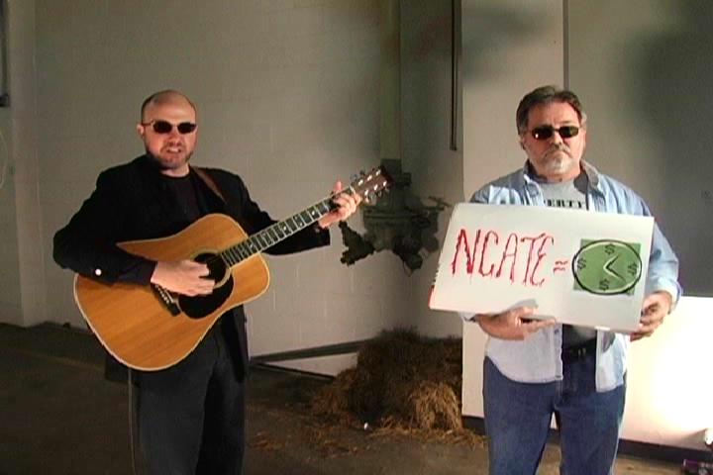

Slide 46
Today’s Challenges for PETE
PETE doctoral programs
Balancing the PETE Curriculum
Accreditation Wagging the PETE Dog
P-12 Physical Education and PETE

Slide 47
Today’s Challenges for PETE
PETE doctoral programs
Balancing the PETE Curriculum
Accreditation Wagging the PETE dog
P-12 Physical Education and PETE
Aligning PETE with public’s expectations

Slide 48
Russ Pate
“The future role of physical education will depend on its ability to provide deliverable outcomes that are consistent with society’s needs and expectations”
October, 2009

Slide 49
Effective PE Interventions for Increased PA
Comprehensive
Long-term
Structured for high rates of MVPA
Pursue targeted health-related learning outcomes
Have a high “fun quotient”
Promote skill development as a motivational mechanism
Provide sufficient amounts of PA time during and after the school day
Are led by the school’s PE teachers
Siedentop, D. (2009). National Plan for Physical Activity: Education Sector. Journal of Physical Activity and Health, 2009, 6(Suppl 2), S168–S180.

Slide 50
Health-Related →Health-Optimizing

Slide 51
Bulger and Housner, 2009
“…Sport, Physical Activity, & Fitness Education Specialists (SPAFES) with a depth of expertise sufficient to meet the expanding health, wellness, and physical activity needs of schools and communities.” (p. 448)
Bulger, S.M & Housner, L. D. (2009). Relocating from Easy Street: Strategies for moving physical education forward. Quest, 61, 442-469

Slide 52
Faber, Kulinna & Darst, 2007
Teacher-Level:
Cooperate with classroom teachers and other school personnel;
Integrate physical activity and health knowledge across the entire school curriculum;
Involve the community;
Find and use available resources, such as those on the internet;
Develop incentive programs to promote out-of-school PA;
Design and assess PA journal logs;
Be positive role models
Faber, L., Kulinna, P.H. & Darst, P. (2007). Strategies for Physical Activity Promotion beyond the Physical Education Classroom. Journal of Physical Education, Recreation & Dance, 78(9), 27-31.

Slide 53
Faber, Kulinna & Darst, 2007
School-Level:
Design and use age-appropriate playground equipment and play spaces;
Introduce a variety of activities in their curriculum;
Design and lead before, during, and after school extra-curricular programs that promote PA;
Be effective promoters of PA;
Make announcements about programs and successes;
Plan PA-based family nights at school;
Work with the school’s food service personnel to plan and provide healthy food choices to children.
Faber, L., Kulinna, P.H. & Darst, P. (2007). Strategies for Physical Activity Promotion beyond the
Physical Education Classroom. Journal of Physical Education, Recreation & Dance,
78(9), 27-31.

Slide 54
PETE’s Future…
Continue to evolve and mature
Find and promote Best Practice
Say hello to old friends
Our best work needs to be ahead of us
Be a key part of the solution, not a perceived part of the problem

Slide 55
Thanks to…
2009 NASPE PETE Conference organizers
Stephen Jeffries and PELINKS4U
Send comments to mmetzler@gsu.edu

