Slide 1
Wikis in Physical Education
Part I: Introduction
Helena Baert
helenabaert@hotmail.com

Slide 2

A wiki is an easy-to-use free web page that multiple people can edit.

Slide 3

Wiki means “quick” in Hawaiian

Slide 4


In the classroom, a wiki is a free tool that empowers every student to participate in group projects.

Slide 5
Three great ways to communicate
with students
Wiki
Blog
Forum
Write
Publish
Comment
Create
Publish
Comment
Converse
Post Ideas
Respond
Share
Edit
Collaborate
Engage
Converse
Post ideas
Respond

Slide 6

Possibilities in Physical Education:
PE Website for parents/students
Collaborative website: e.g. creating games
PE portfolios - PE Dictionary
Brainstorming - Class Notes
Group Work - Research
PE teacher network - PE resource
50 Ways to use wikis in classroom

Slide 7

Mary wants to be sure her students are
protected from the wider internet.
How can she make certain her online site is off limits to child predators?
How can she be sure that her students won’t be drawn onto the web?

Slide 8
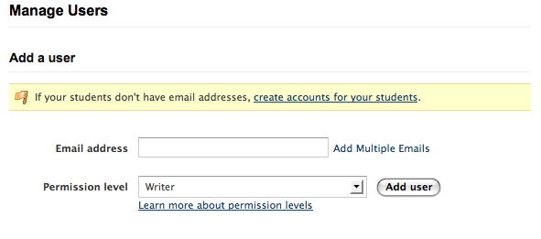
YOU control who sees your wiki
You invite your students
Each student has a unique login and password

Slide 9
Education wikis are free and never display advertisements
NO ADS

Slide 10

Jamie wants to make certain her students act appropriately on line.
Will her students write offensive comments?
How can she monitor her students’ activity?

Slide 11
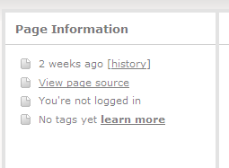
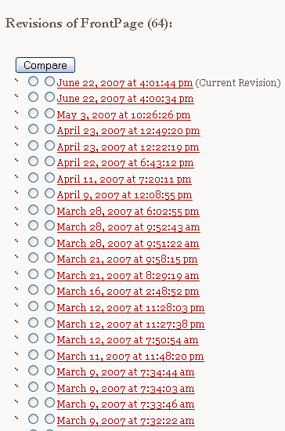
You have a history of every edit
You are notified of every change

Slide 12
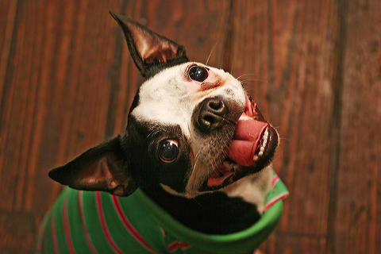
No more “dog ate my homework”
Edits are time-stamped. You know who made changes and when they were made.

Slide 13
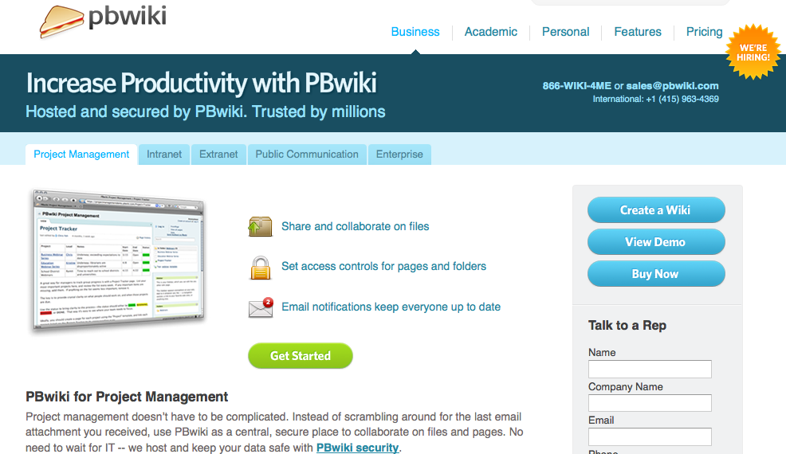
Wikis are Free and Easy to set up
No IT department is needed!

Slide 14
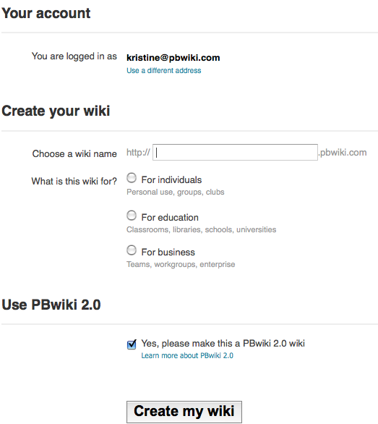
  Simply create a password and begin

Slide 15
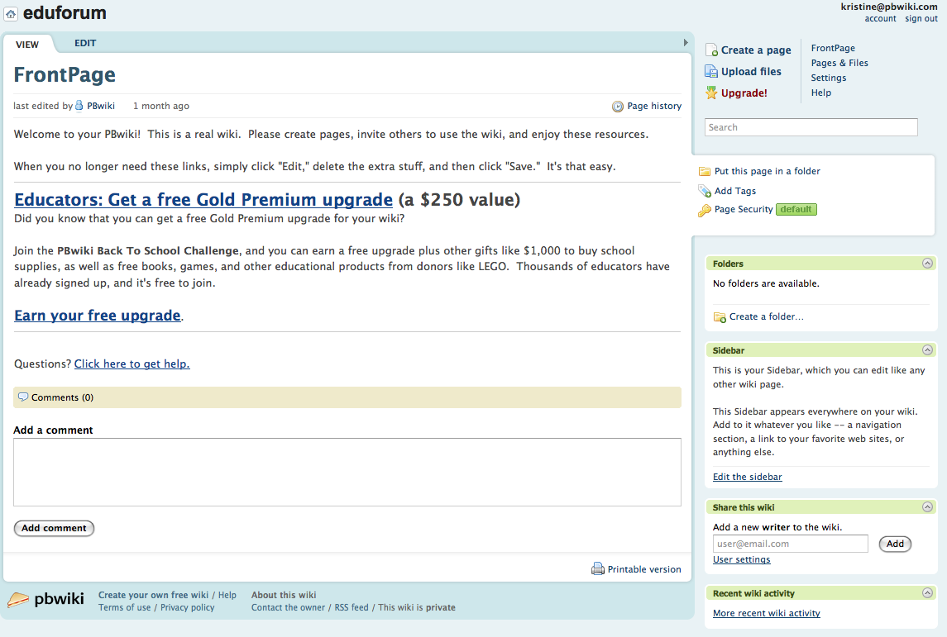
  Set it up and it works
  just like typing in Microsoft Word

Slide 16
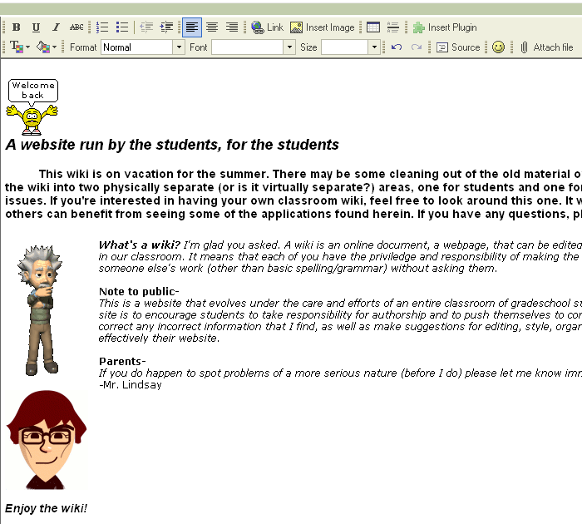
Just like creating a Word document
Just click and begin
Easily insert Images and Video

Slide 17
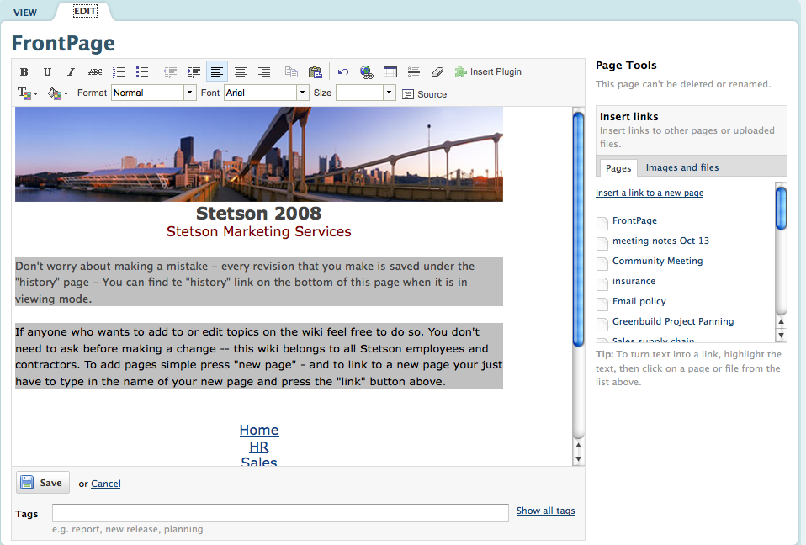
Post a picture or a video

Slide 18

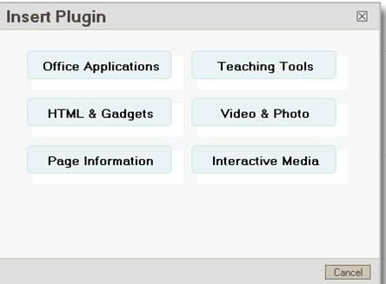
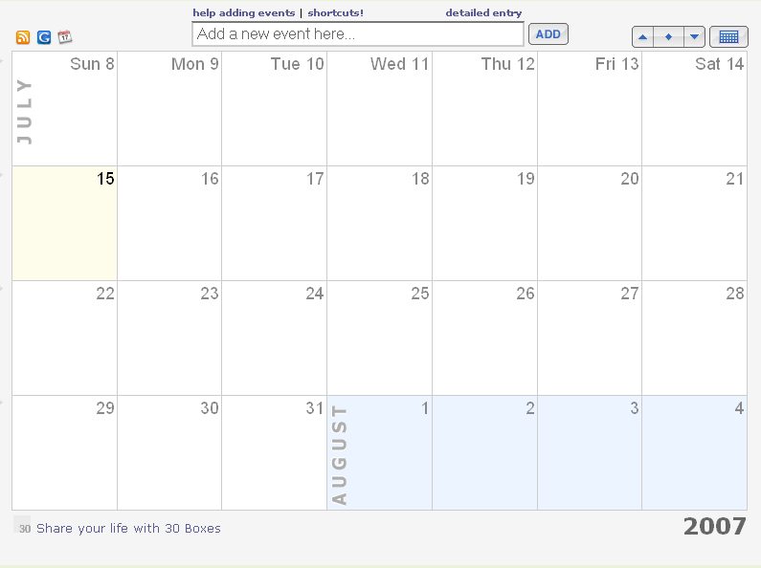
Teachers can make coursework and homework information easily available to both students and parents.
With easy-to-use plug-ins you can create a calendar.

Slide 19
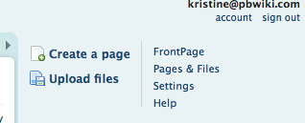
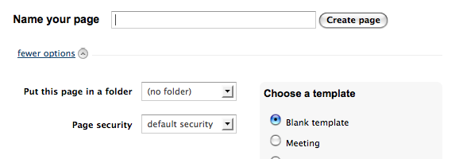
Quickly create new pages
Templates designed with teachers in mind

Slide 20
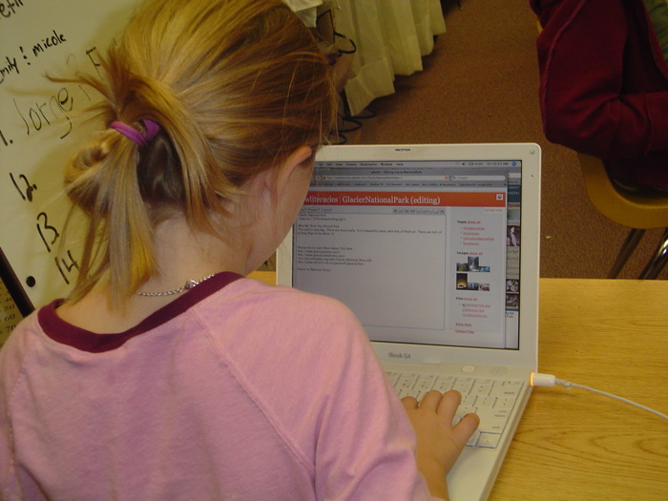

Slide 21

Educator wikis are free, fast, and ready to use.
Create one now at www.pbworks.com
Follow along with Part II to create your own wiki!
Parts of this presentation used with permission of PBWorks @2009

