Slide 1
Wikis in Physical Education Part II Let’s get practical!
Helena Baert
helenabaert@hotmail.com

Slide 2
Part II: Let’s get practical!
The Web as a notebook
This slideshow will help you build a wiki.
Don’t worry if you do not know how and when you will use it, as you can delete the wiki at any time.
Also, you can create a new wiki any time you want, for free!

Slide 3
Steps of creating your own WIKI
Go to www.pbworks.com
Click on “Get Started”
Click on “Educational”
Click on “Try it now!”
Select the "free" option (Basic Edition)
Create a name for your wiki - remember, you can't change the URL once you create it, but you can always make a new one.
Follow the steps of setting up a wiki (for education, K-12, collaborative classroom)
If you do not have an account, PBWorks will ask you to create one for free. You will receive an email that will guide you back to your wiki so you can get started! ☺
Workspace security settings can always be changed later!

Slide 4
First View!

Slide 5
Make it your own!
Title
FrontPage = Homepage

Slide 6
Title!
To Change the title:
Go to Settings

Slide 7
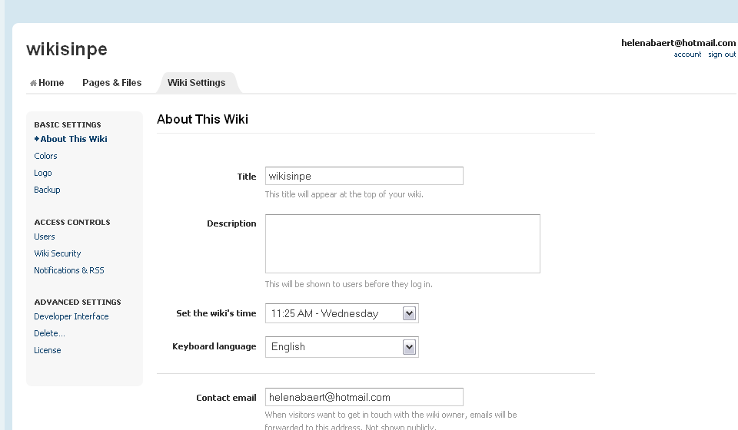
Title!

Slide 8
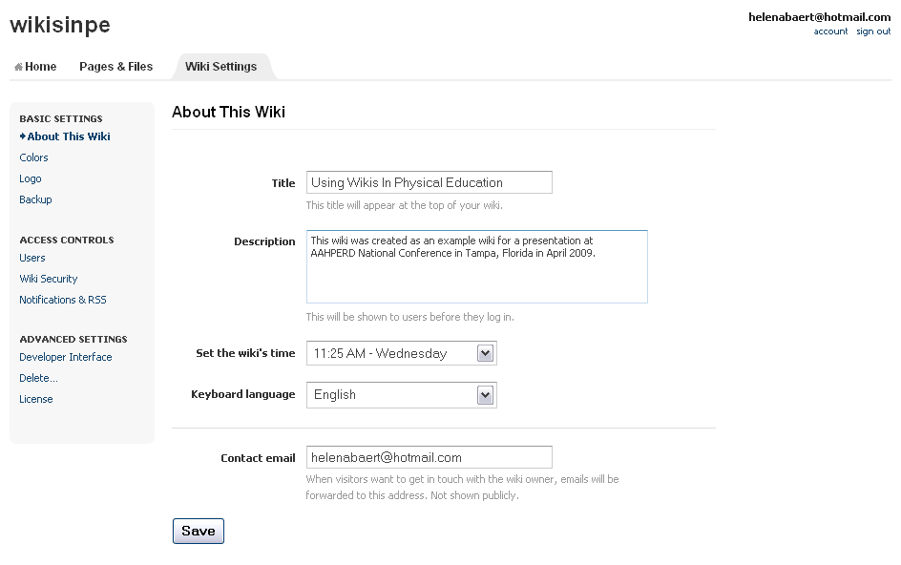
Change settings
Feel free to add the title you wish, this does not have to be your URL.
#1

Slide 9
Change settings
A description can be useful for those wanting to know who the wiki is for.
#2

Slide 10
Change settings
# 3: Change time and language to meet your needs!

Slide 11
Change settings
#4: Add your contact info!

Slide 12
Change settings
#5: Always Click SAVE!

Slide 13
All 5 steps!
Review of the main settings!
#1
#2
# 3: Change time and language to meet your needs!
#4: Add your contact info!
#5: Always Click SAVE!

Slide 14
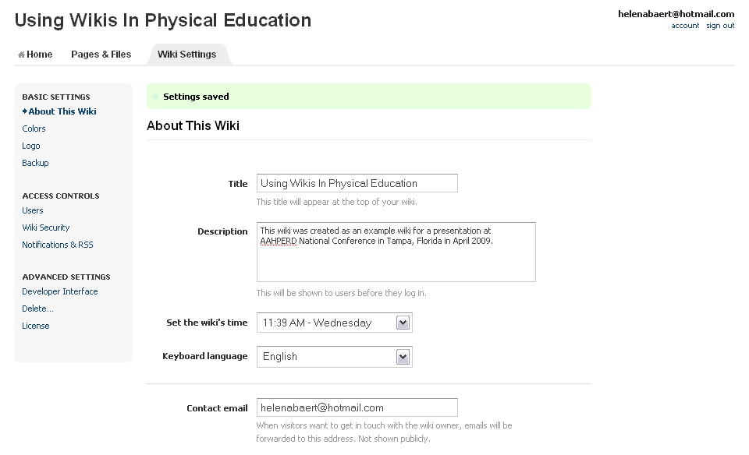
Saved!

Slide 15
Changing the color
Changing
The color

Slide 16
Setting Security Features
Wiki security

Slide 17
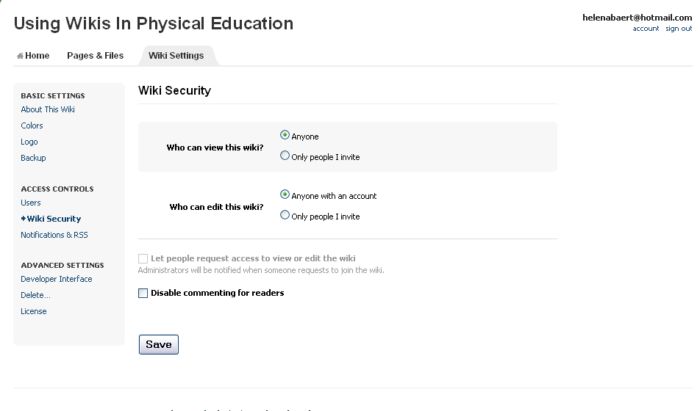
Wiki Security
3 Choices!
Who can see the wiki
Who can edit?
Full control: only have people on it that you invite.
(This may not be optimal for a class website as you may want parents to be able to view the content)

Slide 18
Changing your own notifications

Slide 19
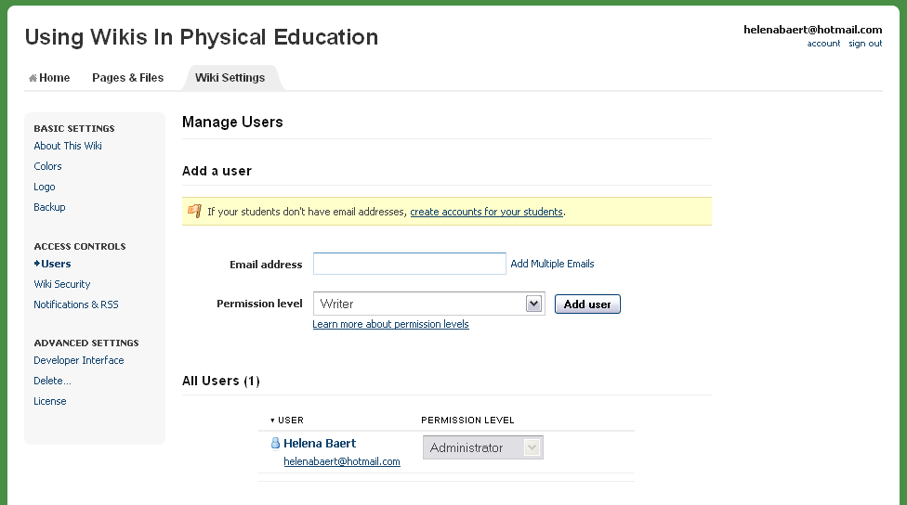
Users
Here you can create accounts for all your students! No need for them to have an email address, and you will always know their passwords if they forget!
If your students have email addresses, you can add them by using that address.

Slide 20
Creating a new page/ folder
Creating a folder:
Creating a new page:
Front Page
“Page and Files”
“New”
New page or new file
Go to front page
Click “Create a Page”
Give your page a name
Put your page in a folder

Slide 21
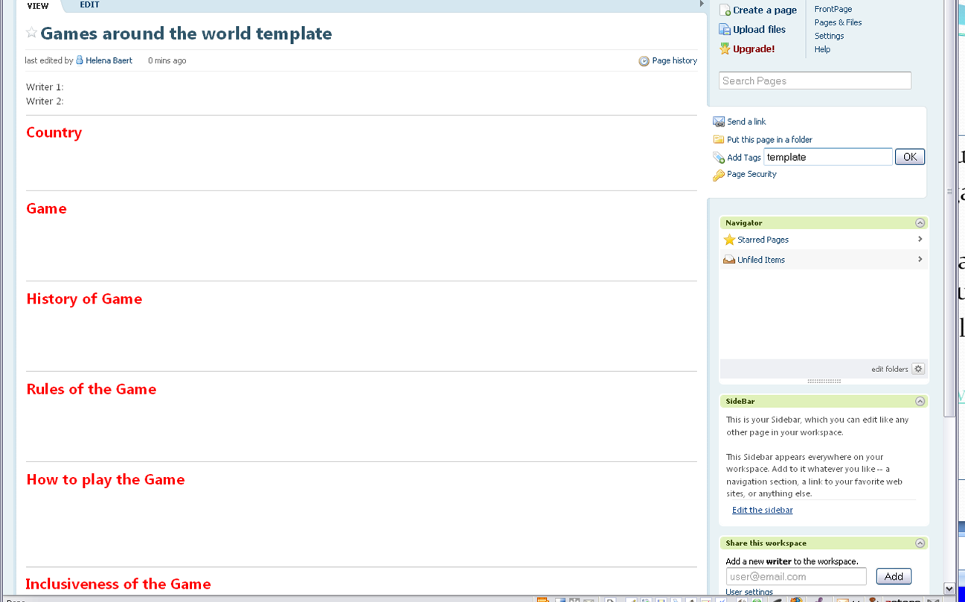
Add a template
If you want your students to use the same format.
E.g. lesson plans, creating a game, writing a paragraph, doing a project
You can create a page and by adding the tag “template,” you create a template that you can copy.

Slide 22
Editing a page
Click “Edit”
Use the “WYSIWYG” editor – as easy as using word.
Type away!
Insert pictures:
Insert links/images and files
Upload files (create picture folder/ file folder)
Click on picture/file to insert where cursor appears

Slide 23
Linking
Creating links between pages makes a wiki more interactive
How to add a link?
Link to other wiki page
Link to new wiki page
Link to folder
Link to URL
Link to Email
Always remember to put the cursor where you want the link to be.

Slide 24
Using Plug-ins
Click the ‘Insert Plugin’ Button in Edit Mode
Calendar
PowerPoint Slideshow
Equation
Footnote
Upload Video
Photo Slideshow
TeacherTube Video
YouTube Video
HTML/JavaScript
Google Gadget
Include another page
Recent visitors
Table of Contents
# of visitors
Skype
Voki Speaking Avatar

Slide 25
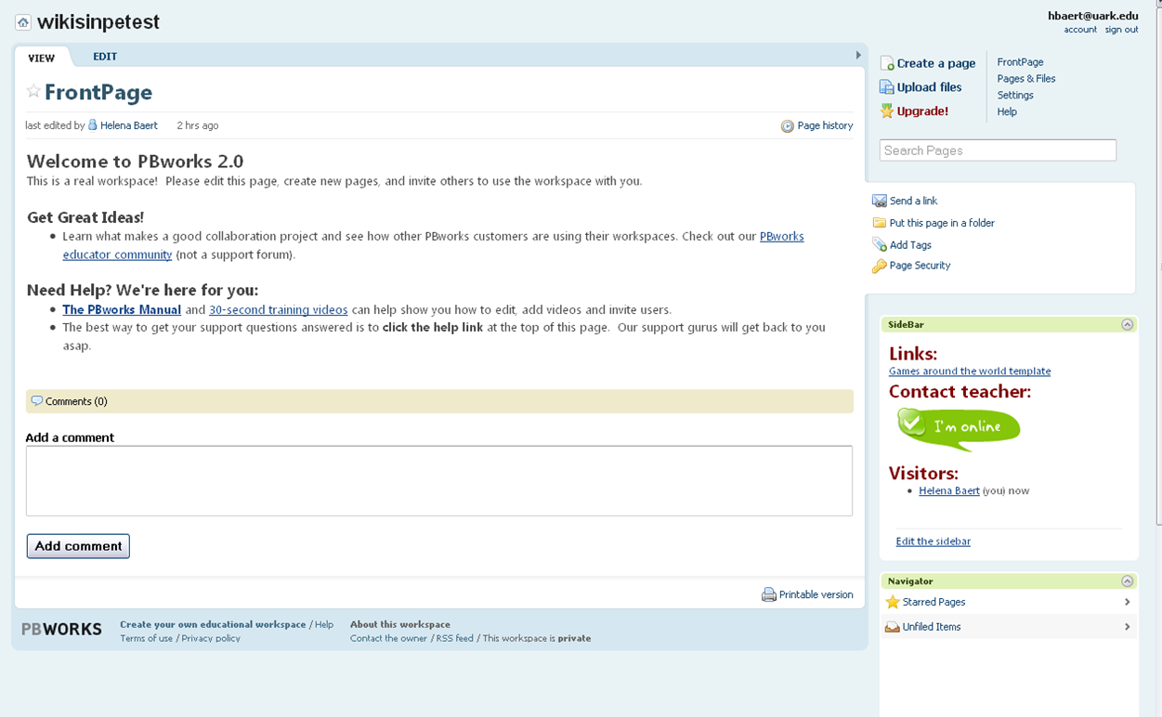
A few final tricks
Remove formatting
Source (coding behind text)
Side bar
Add links,
contact information,
visitor count,
table of contents, …

Slide 26
Your turn! Try this!
Edit a page
Create a new page
Create a folder
Put the page in the folder
Add a link to page/URL/email
Add a picture
Add a file
Add a gadget
Add a calendar

Slide 27
For more ideas check out the PBworks educator page. You can find tips, suggestions, templates, and a community of fellow teacher users.
http://educators.pbworks.com

Slide 28
Thank you!
More info: helenabaert@hotmail.com
Email me if you have any questions or you need assistance with your wiki.

