Slide 1
Wikis in Physical Education Part III
Notifications & RSS
Helena Baert
helenabaert@hotmail.com

Slide 2
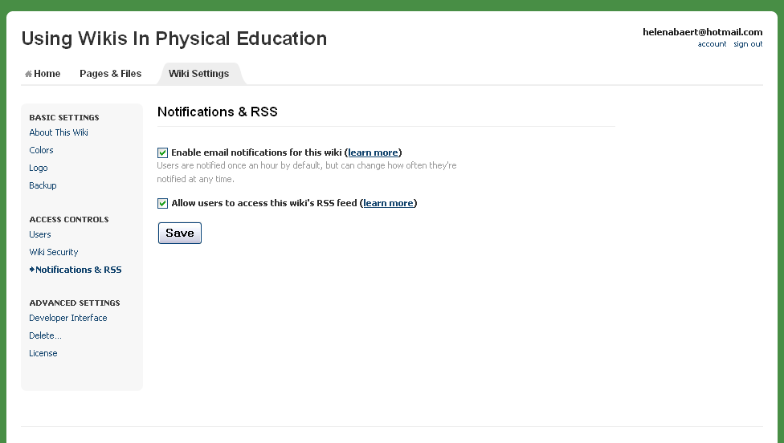
Notifications & RSS
From experience, I tend to remove the check so my students do not receive multiple emails when they sign up for the wiki.
You can change notifications when you go to your personal account.

Slide 3
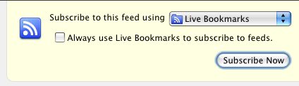
RSS Feeds
RSS is a method for subscribing to changes made on your wiki so you can see what has changed more easily. Most web browsers include RSS readers and generally show a feed icon somewhere near the address bar (the icon is orange in most browsers, but it's blue in Safari.)
When you click this icon, you'll see a list of available feeds. Here's what that looks like in the Firefox browser.

Slide 4
RSS Feeds (2)
Your Pbworks wiki has a few feeds you can subscribe to:
  The Recent Changes feed includes all recent changes on your wiki, including page edits, comments, file uploads -- you name it.
  Each wiki page has its own feed that only includes edits and comments on that particular page.
  Each folder has its own feed that includes edits and comments made to any page in that folder.

Slide 5
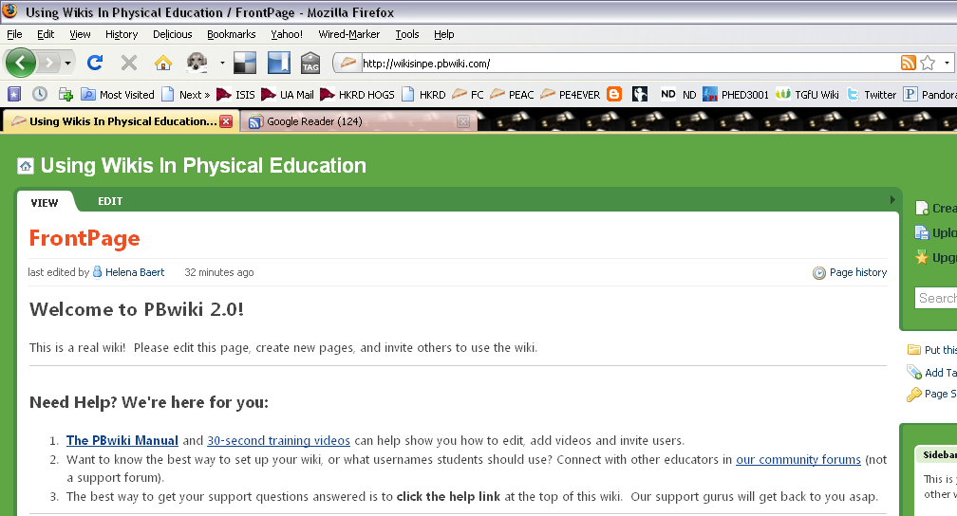
Getting RSS feeds to your reader

Slide 6
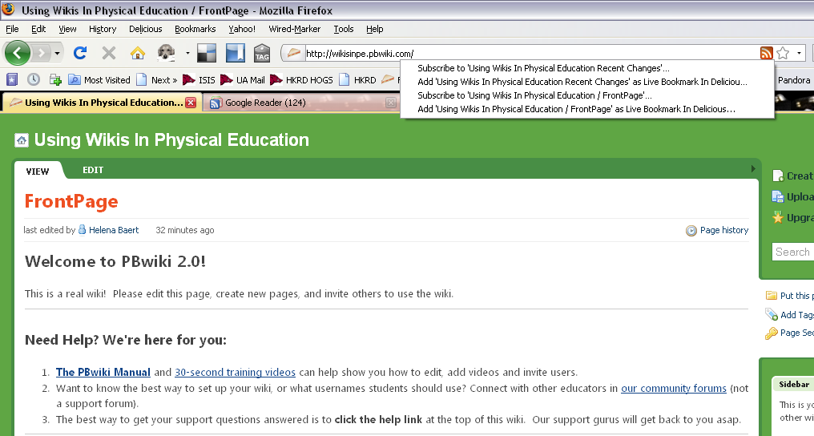
Click on the orange notification

Slide 7
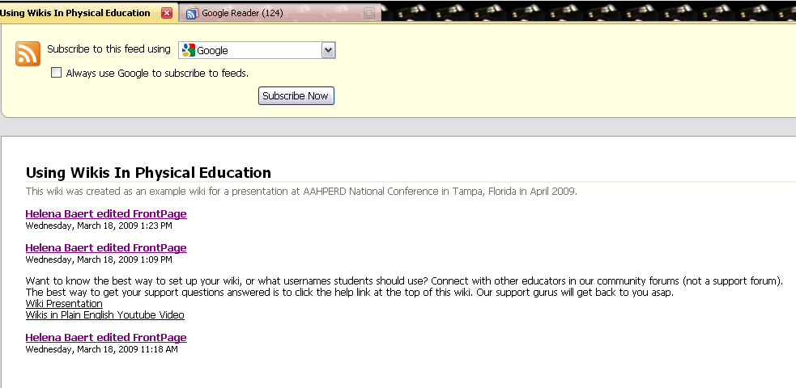
Subscribe using Google Reader
If you do not have Google reader, sign up for free for a Google account at www.google.com

Slide 8
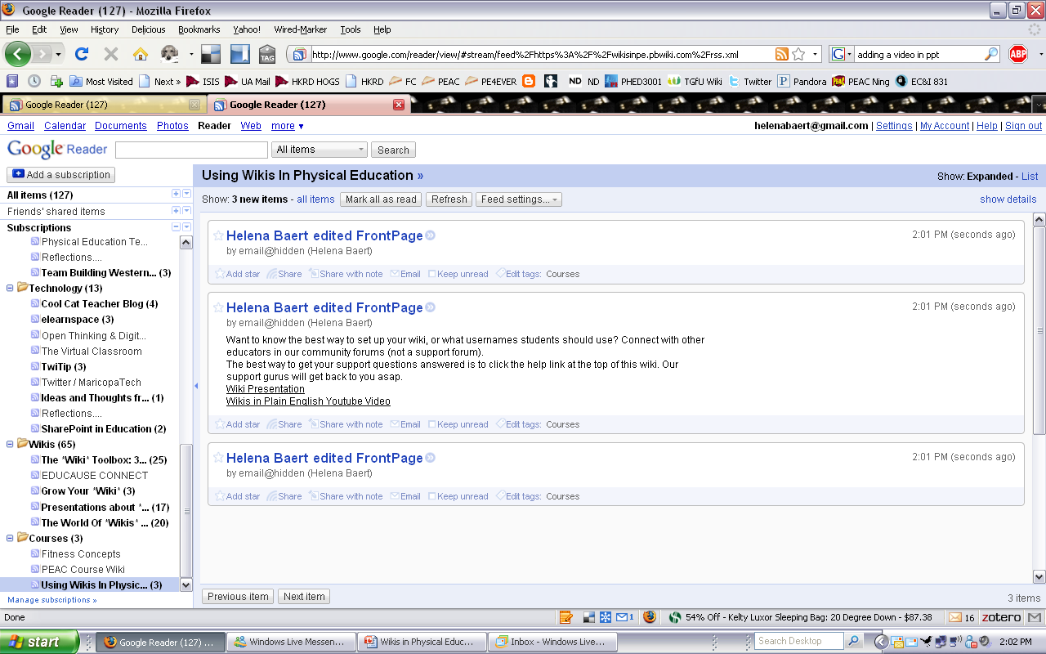
Every time someone edits.. I will know!

