Slide 1
Participant Outcomes:
1. Recognize two needs:
  Less talk, more action!
  One resource teaching both physical and nutrition education.
2. Become a leader to decrease childhood obesity,
improve children’s wellness, and optimize academics.
3. Re-examine the Local School Wellness Policy.
4. Receive information on an innovative fitness program
for kids—the bSAFE bFIT! Program for kids.
5. Walk away with ready-to-use learning strategies that
excite children to be physically active while engaged in
physical and nutrition education; linking schools, families,
and the community.

Slide 2
CHILDHOOD OBESITY
Physical and Emotional Ramifications

Slide 3
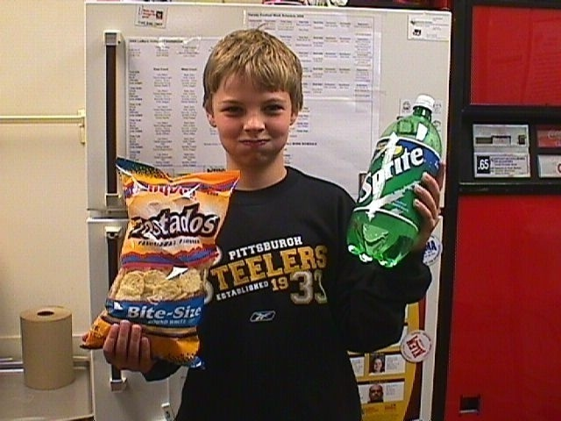
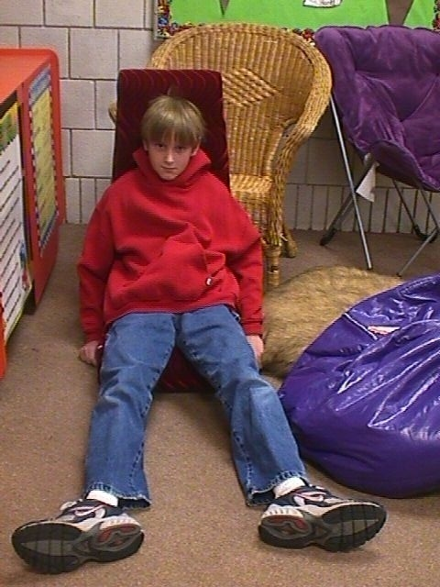
KEY CULPRITS
  Poor nutrition Lack of physical
  activity

Slide 4

ONE RESOURCE
TEACHING BOTH
We can’t “CHANGE” behaviors unless we “TEACH HOW”

Slide 5
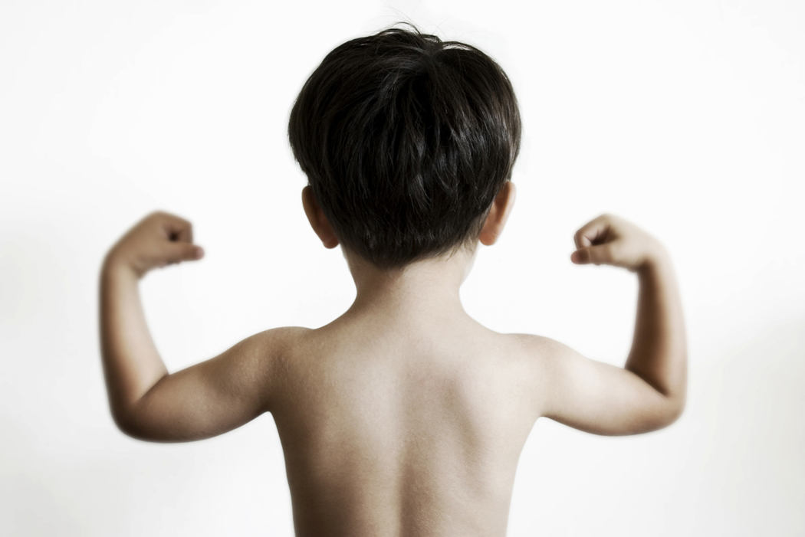
EARLY EDUCATION
Those working with children as early as age 2
play a critical role.

Slide 6

LINK TO ACADEMICS
Physical Activity Healthy Eating

Slide 7
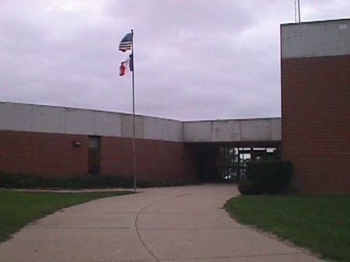
AVENUES
School
Family
Community

Slide 8
SCHOOL WELLNESS POLICY
The Child Nutrition and WIC Reauthorization Act
Required for schools participating in the National School Lunch Program
Section 204 addresses Physical Activity and Nutrition education

Slide 9

LESS TALK
MORE ACTION
Only words
without action!

Slide 10
PHYSICAL EDUCATOR
LEADERSHIP ROLE

Slide 11

UNIQUE STRATEGY
bSAFE bFIT! Program
for kids
Perfect “fit”—focus on both physical and nutrition education!

Slide 12
FITNESS PALS
WATERMELON JACK
Physical Activity
Aerobic Fitness—
Jumping Jack
Food Group
Fruits
WATERMELON JACK! (Fruits, Aerobic Fitness)
Wow! Stand with your feet together and arms down at your sides. Jump, spread your feet apart, and lift your arms above your head. Return to how you started. Repeat in rhythmic motion!

Slide 13


TWO RESEARCHED-BASED
RESOURCES COMBINED
National Association for Sport and Physical Education (NASPE)
National Standards for Physical Education
United States Department of Agriculture (USDA)
MyPyramid for kids
bSAFE bFIT!—ONE RESOURCE TEACHING
BOTH PHYSICAL AND NUTRITION
EDUCATION

Slide 14
EASY TO
IMPLEMENT
  Portions of physical education curriculum
  Portions of nutrition education curriculum
  Beginning or end of day, before or after school
  programs, activity breaks, etc.

Slide 15
CONCERN FOR
TIME
  Short and to the point
  5 to 10 minute instant lessons

Slide 16
CROSS CURRICULAR
PHYSICAL EDUCATION
CLASSROOM
HEALTH
MATH
SCIENCE
LITERACY
ART
MUSIC

Slide 17

CHILDREN MOVING
WHILE LEARNING!
EDUCATORS MEETING
SCHOOL WELLNESS
POLICY GOALS!

Slide 18
HANDOUT Crab-by Spelling Relay
HANDOUT Crab-by MyPyramid Relay
ACTIVITY
TIME!

Slide 19
“bSAFE”
Five components of health-related physical fitness
b “b”ody Composition
S “S”trength
A “A”erobic Fitness
F “F”lexibility
E “E”ndurance

Slide 20
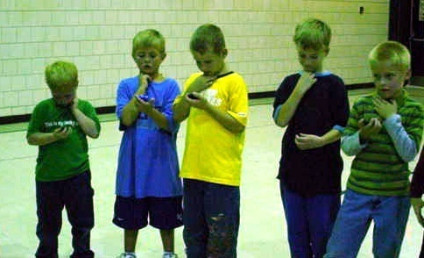
SQUADS—groups of 5
Body Composition Squad
Strength Squad
Aerobic Fitness Squad
Flexibility Squad
Endurance Squad
Grains Squad
Vegetables Squad
Fruits Squad
Milk Squad
Meat & Beans Squad

Slide 21
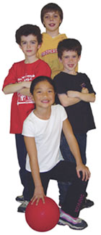
bSAFE bFIT!
Educational Tools
Manual with Lesson Plans
Posters—five 18 x 24”
Activity Cards—55
CD—10 songs
Instructor DVD

Slide 22
bSAFE bFIT! MANUAL with LESSON PLANS
HANDOUT Lesson 5
HANDOUT Lesson 22
Age 2-Preschool
Kind-2nd
3rd-6th
Sequential
5 to 10-minute lessons

Slide 23
bSAFE bFIT! MANUAL with LESSON PLANS MAIN CONCEPTS
Body shapes and sizes
PEDIATRICIAN IS THE BEST PERSON TO TALK TO ABOUT A HEALTHY BODY
Calorie Needs and Expenditures
Children 2-3 1000 1000-1400
Children 4-8 1200-1400 1400-1800
Girls 9-13 1600 1600-2000
Boys 9-13 1800 1800-2600
Physical Education—National Association for Sports and Physical Education
Warm up and Cool down
Strength and Endurance
  Seven major muscle groups
  NASPE recommendations of 2 to 3 times a week using own body weight
Aerobic Fitness
  How to take heart rate
  Children’s resting heart rate (also appears on the poster)
Flexibility
  NAPSE recommendations—slow stretching
Nutrition Education—USDA MyPyramid
Food Groups—Grains, Vegetables, Fruit, Milk, Meat and Beans
What foods are in each group(Fruits)
  Apples, oranges, grapes, etc.
USDA recommended daily amounts
  Children 4 to 8 1 to 1 ½ cups
  Girls 9-13 1 ½ cups
  Boys 9-13 1 ½ cups
What counts as an amount
  1 small apple equals 1 cup
  1 cup grapes is equal to 1 cup

Slide 24
HANDOUT Rock n’ Roll
ACTIVITY
TIME!

Slide 25
FITNESS PAL POSTERS
Visual Learning
One poster for each component
Definitions
Ideas given by Fitness Pals

Slide 26
HANDOUT bSAFE bFIT! Fitness Pal sample
FITNESS PAL ACTIVITY CARDS
55 Fitness Pals (5 components, 5 food groups)

Slide 27
MOVE N’ WITH FITNESS
PALS CD
10 songs

Slide 28
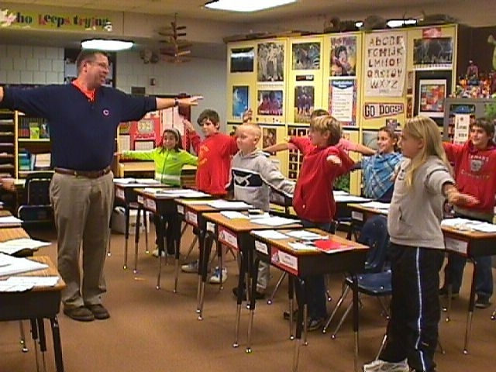
FABULOUS FIT FRIDAY
Song played over intercom every Friday a.m.
School-wide moving while learning
Older students lead younger students

Slide 29
HANDOUT Move n’ with fitness Pals CD
Track #1 Beet n’ Feet
ACTIVITY
TIME!

Slide 30
bSAFE bFIT!
Instructor DVD
Information
Demonstrations

Slide 31
LEMARS COMMUNITY SCHOOL DISTRICT
Policy Language into Action

Slide 32

WELLNESS ACTION PLAN COMMITTEE
          Assess
          Write Goals
          Construct
          Apply
          Implement
          Evaluate

Slide 33
CONSTRUCTING
WELLNESS
LEARNING
STRATEGIES

Slide 34
HANDOUT Constructing Learning Strategies Template
Learning Strategy:
Objectives:
Suggested Grade Level:
Educational Tools
Handout(s):
Activity Sheet(s)
Sample Parent/Community Letter(s)
Other
Preparation
Description
Grouping:
Additional Information
Physical Activity
Physical Education
Nutrition Education
Linking Schools, Families, and the Community

Slide 35
bSAFE bFIT! NEWSLETTERS
Physical and Nutrition Education
Linking schools, families, and
the community
WELLNESS
Childhood obesity has become a national concern. Overweight children are experiencing physical and emotional physical and emotional ramifications that are affecting
their current and future health. Two key culprits have been identified as to reasons why childhood obesity is on the rise—
PHYSICAL EDUCATION
Years ago, Physical Education was a sports promotion curriculum. However, major changes are erupting to transform the focus to self-improvement rather than being
the best in a sport. My ultimate goal for your child’s experience in Physical Education is that they develop the skills and attitudes to enjoy participating in lifelong
physical activity. In order for your child to adopt a healthy and physically active
NUTRITION EDUCATION
A unique program I am using to implement nutrition education into my existing physical education curriculum
is entitled the bSAFE bFIT! Program for kids. Portions of both the physical and nutrition education curriculums are
We” can make a positive difference in your child’s life when
“we” work together!
Let’s be safe and be fit!

Slide 36






CONTACT INFORMATION
Renae Buss
www.bsafebfit.com/contact us
712.546.6005
Order online
www.strikersportsllc.com
321.253.3551
Catalogs
GOPHER
All educational tools range $139 to $179

Slide 37
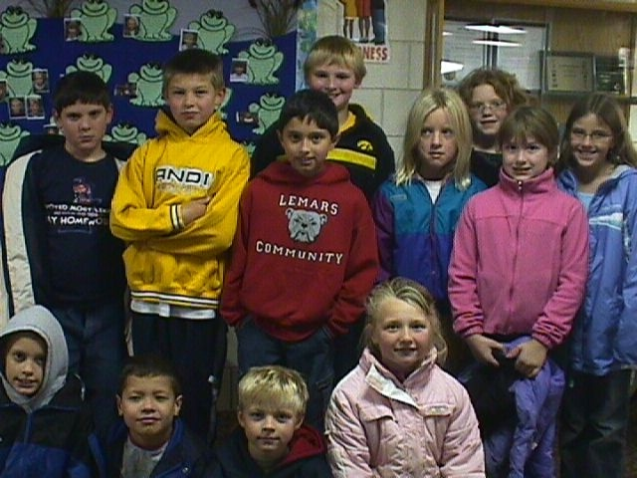
MEANS TO AN END
PHYSICAL EDUCATORS ATTACKING CHILDHOOD OBESTITY
Implement Nutrition into Physical Education
One resource teaching both physical and
nutrition education
Puts School Wellness Policy language into action
bSAFE bFIT! is a perfect fit!
Decreasing Childhood Obesity
      Optimizing Academic

Slide 38
ACTIVITY
TIME!

